Slide 1
Introduction to Arduino
The cardboard box for geeks

Slide 2
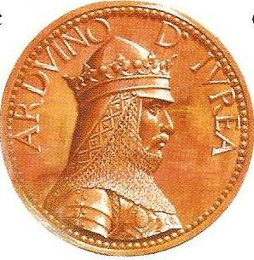
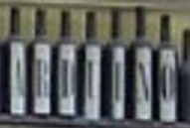
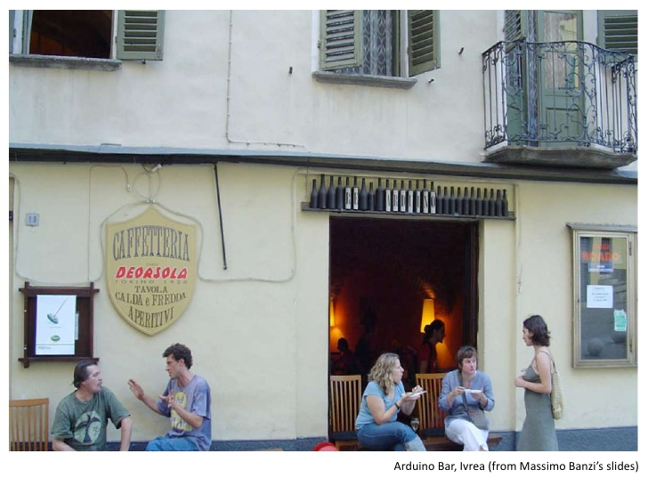
In The Beginning…
The first Arduino
955 – 1015 A.D
King of Italy 1002-1014
Arduino Namesake
Bar in Ivrea Italy

Slide 3
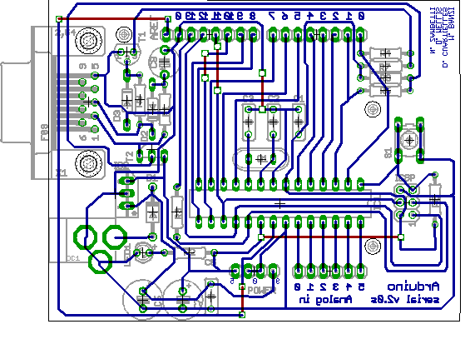
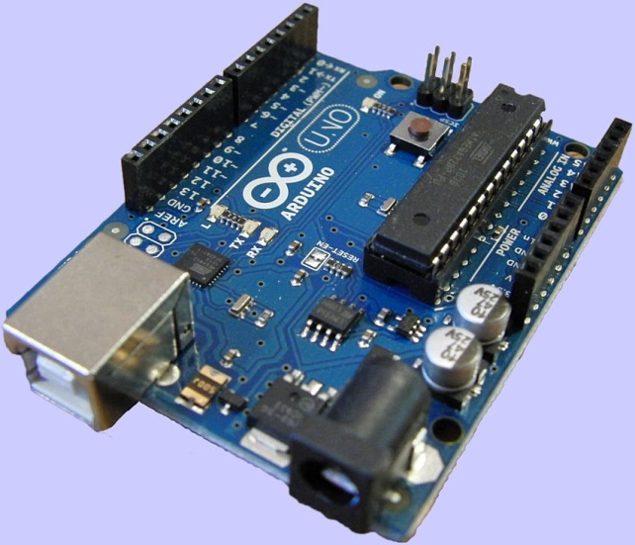
Arduino As We Know It
Arduino (2005)
First board / design
Arduino Uno (2010)
R3 Released 2013

Slide 4
Design Goals
Designed by 5 students
Affordable
Open Source
Easy to program for beginners

Slide 5
Design Success!
Designed by 5 students
Affordable
< $30
Open Source
Creative Commons license
Easy to program for beginners
700,000 + Official Arduino Boards sold (2013)

Slide 6
Show and Tell
Arduino Uno R3
Arduino Yun (linux and Wifi built in)
Trinket Pro (Arduino compatible)
Shields
Motor / Servo controllers
BlueTooth LTE
GPS
Data Logging
Many more!

Slide 7
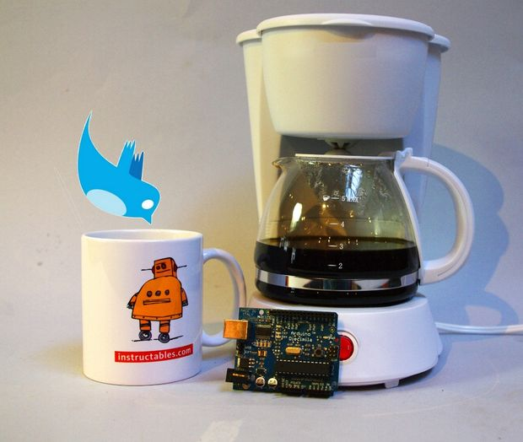
The Cardboard Box for Geeks
Twitter enabled coffee maker.

Slide 8
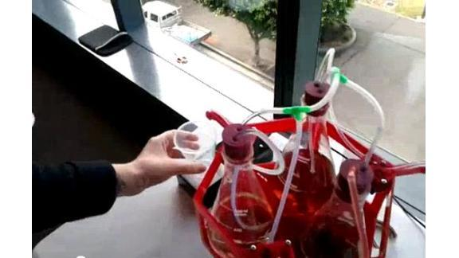
The Cardboard Box for Geeks
Remote Bartender.

Slide 9
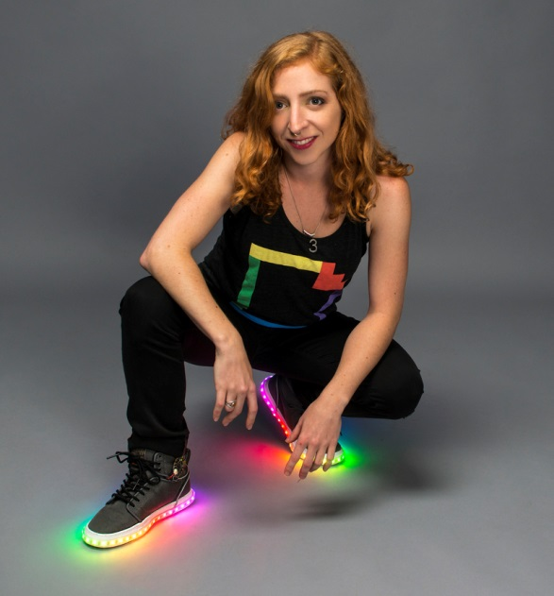
The Cardboard Box for Geeks
Shoes that flash when you walk.

Slide 10
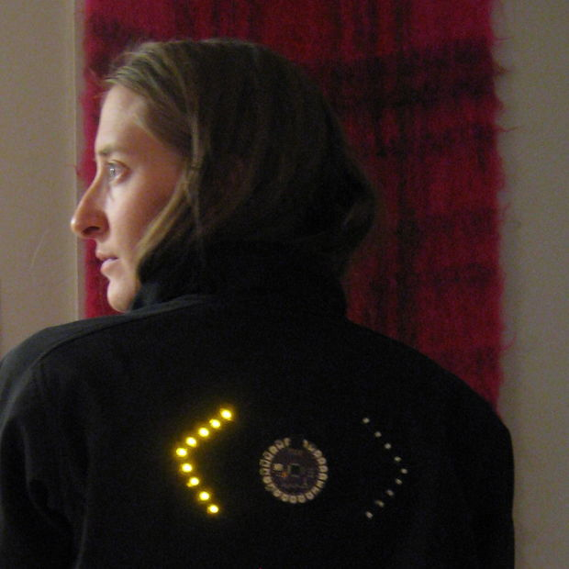
The Cardboard Box for Geeks
Turn Signal Jacket.

Slide 11
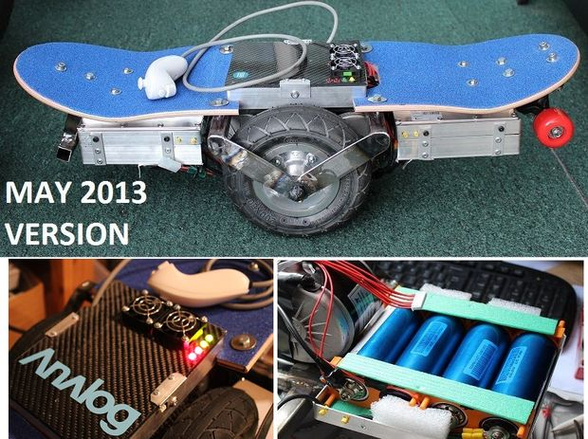
The Cardboard Box for Geeks
Segway style skateboard.

Slide 12
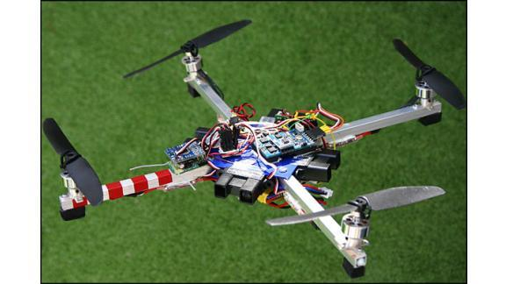
The Cardboard Box for Geeks
Quadcopters!

Slide 13
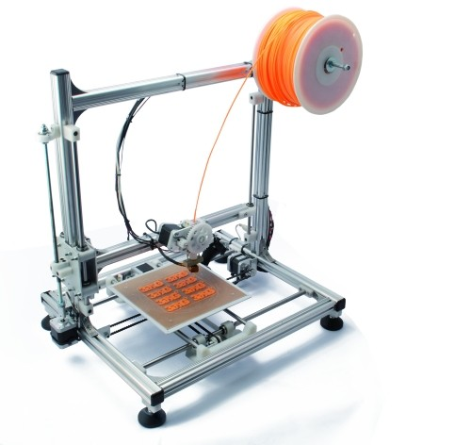
The Cardboard Box for Geeks
3D Printers!

Slide 14
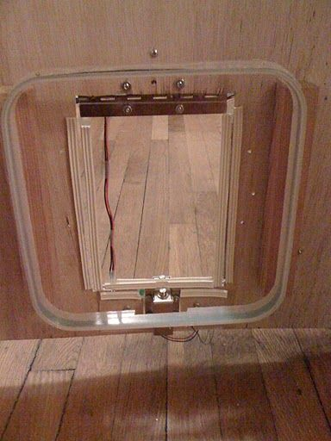
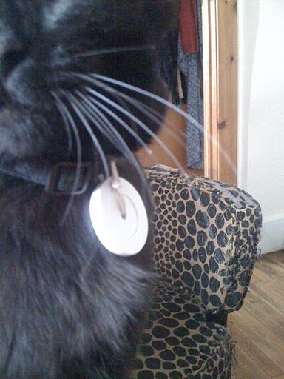
The Cardboard Box for Geeks
RFID Cat Door

Slide 15
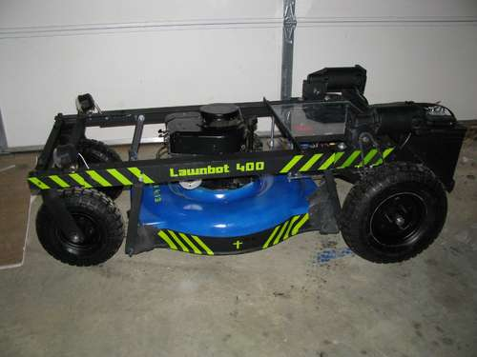
The Cardboard Box for Geeks
Remote Controlled Lawnmower.

Slide 16
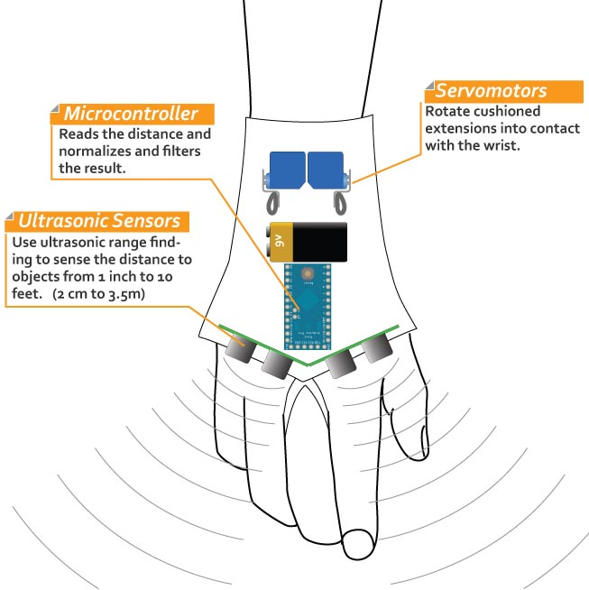
The Cardboard Box for Geeks
Sonic Glove for the blind.

Slide 17
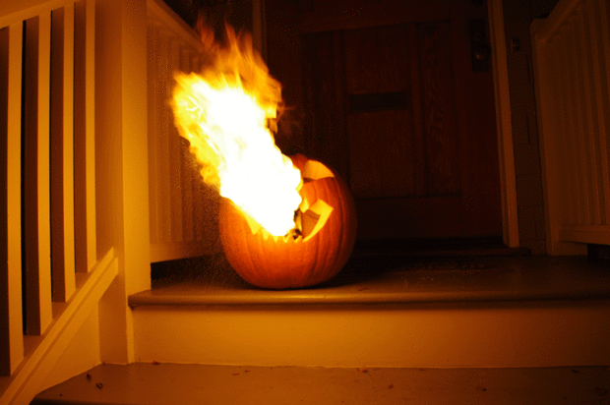
The Cardboard Box for Geeks
Flame throwing Jack O’ Lantern.

Slide 18
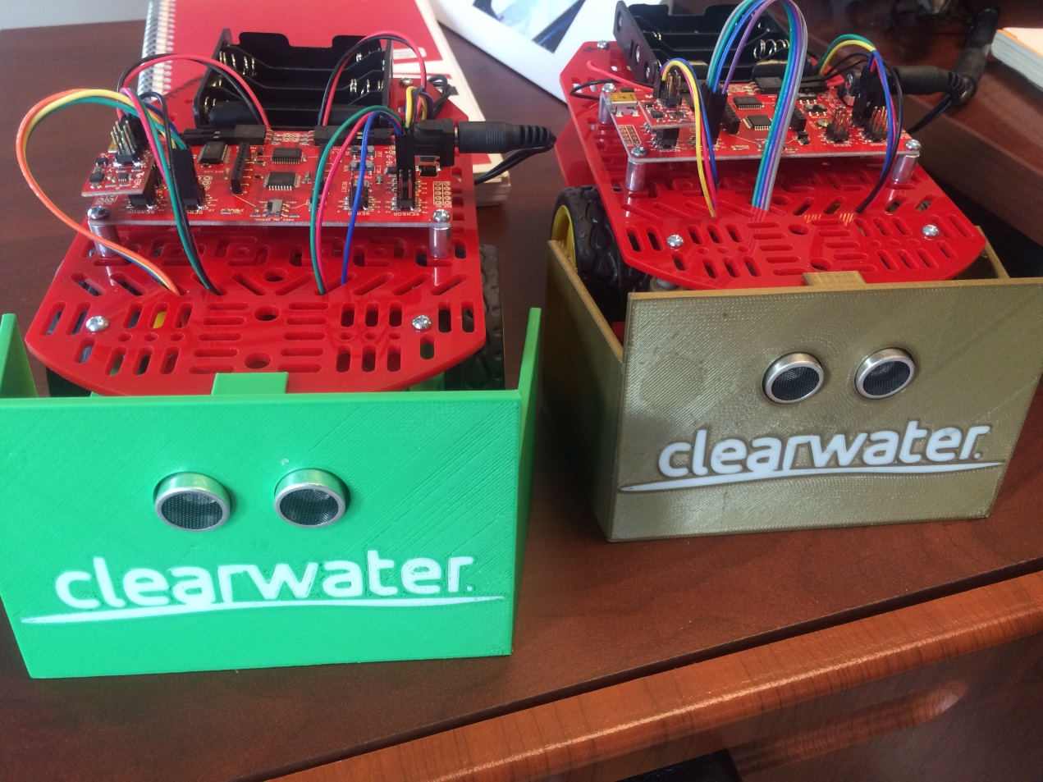
The Cardboard Box for Geeks
SUMO BOTS!

